Slide 1
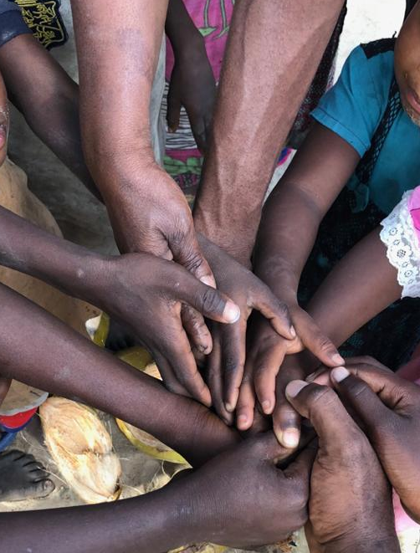

Crowdfunding for Real Estate Investment- A Strategic Approach to Achieving Tanzania’s Vision 2050
An Opening Address
By
FRV Dr Felician Komu, May 2026

Slide 2
Presentation Outline
Welcoming address (protocols)
Word about the Conference organizers
Expectations from the Conference- the Agenda
Briefings on Crowdfunding
What is Crowdfunding
What are the types and the process
How do we make use of the Crowdfunding
Conclusions

Slide 3
Welcoming address
The Protocols
The 2026 AREPTA Theme
  Realization of the motto ‘ united we stand, divided we fall’. Why?
    AREPTA vows to be a group of professional women and men of action
    AREPTA members are enthusiastic about technology- what for?
      Transform traditional real estate practices
      Remain relevant to the society.
    AREPTA Focus:
      Proptech – appreciating how technology is shaping real estate investment, finance, valuation and related advisory services
      Crowdfunding- the 2026 theme, the mantle and the key to achieve tangible reality:
        AREPTA members invited to be ‘creators’ for the Dodoma AREPTA land.
Why this presentation?
  A teaser about crowdfunding, exploring our direction for the next decade

Slide 4
What is Crowdfunding
An online fundraising scheme to meet a set goal and garner support for that goal.
Searching for funding is challenging but necessary for startups. Multiple sources of capital are available to today’s entrepreneurs.
A recent comer on the market that has democratized the financing process by providing access to capital where traditional funding options may fall short
A method of raising capital for a business, project, or cause by collecting small amounts of money from a large number of people, typically via online platforms.
An alternative to traditional funding models: It bypasses traditional financial gatekeepers like banks or venture capitalists, allowing creators to connect directly with supporters (often called backers).
A product of the advent of internet and social media-? M-koba

Slide 5
Why Crowdfunding
Market Validation: A successful campaign proves there is real customer demand for a product before it is even made.
Audience Building: It turns early supporters (delegates to 2026 AGM) into brand ambassadors who provide feedback and help market the product
Early Feedback: Backers often provide insights that allow creators to refine their products before a full-scale launch

Slide 6
Crowdfunding Process
Selection of Platform & Model: The creator chooses a platform—such as Kickstarter, Indiegogo, or GoFundMe—that aligns with their goals.
Setting Goals: Creators set a specific monetary goal and a time limit, typically between 30 and 90 days.
Launching the Pitch: This involves creating a campaign page with a compelling story, images, and often a video to explain the project and what backers will receive in return.
The Campaign: Creators market their idea through social media, email, and their existing networks to build momentum.

Slide 7
Crowdfunding Process
Funding Logic:
All-or-Nothing: If the goal isn't met, no money is collected, and backers are not charged (common on Kickstarter).
Flexible Funding: The creator keeps whatever amount is raised, even if they miss the goal (often available on Indiegogo).
Fees: Platforms typically take a cut of the successfully raised funds, often around 5%, plus payment processing fees of roughly 3% + $0.30 per transaction.

Slide 8
Types of Crowdfunding
Rewards-Based: Backers receive a "perk" or the product itself once it is manufactured. It acts as a pre-order system for new inventions or creative projects.
Equity-Based: Investors receive shares of ownership in the company. This is highly regulated by bodies like the Dar Stock Exchange (DSE) and is used by startups looking for larger capital infusions
Donation-Based: Contributors give money purely to support a social, charitable, or personal cause with no expectation of any return
Debt-Based (P2P Lending): Backers lend money that the borrower must repay with interest over a set period, similar to a traditional loan

Slide 9
Choosing the right type of Crowdfunding
Key considerations
Nature of Business or Project
  For a new product/service: Reward-Based crowdfunding is likely to be the best fit
  For a project with a strong social or community-oriented mission, donation-based CF could be a good choice
  In a business restructuring, the equity-based CG could be the best option
  If confident to repay a loan and maintain full ownership of the project, then debt-based CF could be an option
Financial needs and objectives
  For larger amounts, equity or debt-based crowdfunding may be more suitable
  For a smaller amount, reward or donation-based crowdfunding might suffice.

Slide 10
What are the benefits
Aren’t they obvious from the definition? Well!
As an innovative way for startups to raise the funds they need to launch or grow their businesses:
  access to capital that they might not have been able to secure from traditional funding sources, such as banks or venture capitalists.
  Market validation: a successful crowdfunding campaign can demonstrate there is demand for your product or service and act as a proof of concept for other investors and stakeholders.
  Audience building: A crowdfunding campaign allows you to reach a large number of people, helping you create awareness and build an audience. Those who contribute to your campaign are likely to become your most passionate customers and vocal advocates.

Slide 11
What are the benefits
Feedback and insights: Through the process of crowdfunding, you can receive feedback on your product or service before it officially launches. Backers can provide valuable insights and suggestions for improvements.
Less risk: Compared to traditional funding methods, crowdfunding can be less risky. You’re not giving up equity or taking on debt; instead, you’re exchanging your product or service for funding.
Publicity and marketing: A successful crowdfunding campaign can lead to significant publicity, through social media shares and likes and traditional media coverage.
Partnership and networking opportunities: Crowdfunding campaigns often catch the eye of industry leaders, potential partners, and even other funding sources. This visibility can lead to strategic partnerships and further investment opportunities.

Slide 12
Conclusions
AREPTA is a not-for-profit professional association- funded by its members subscription.
AREPTA brings together hundreds of individuals with real estate skills and differing innovative minds and developmental orientation.
Together AREPTA has an important role to play:
  for its own survival through the human resources espoused to itself and physical resources it owns
  For the achieving of the Tanzania’s Vision 2050 in three key areas
    Digital transformation
    Boosting private-sector-led growth and
    Contribution towards sustainable development for the country
Charity begins at home – and with the Dodoma plot – crowdfunding is the surest way to go

Slide 13
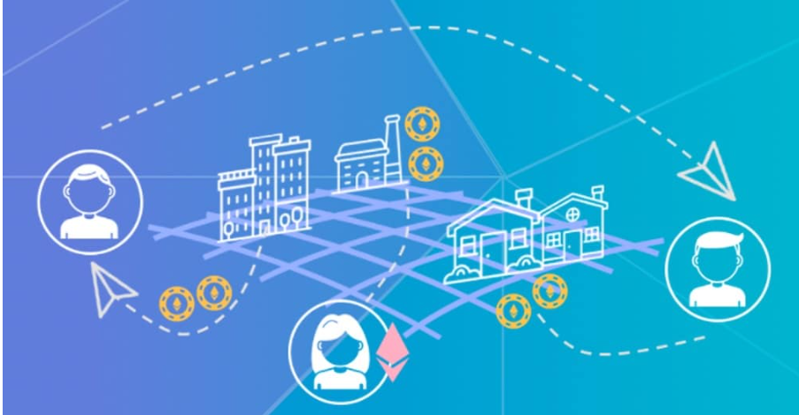
Thank You for Attention
Asanteni Sana

